Slide 1
Elementary Statistics – Principles of Hypothesis Testing
Dr. Ab Mosca (they/them)
Slides based off slides courtesy of Kaitlyn Cook (https://www.smith.edu/people/kaitlyn-cook)

Slide 2
Plan for Today
Hypothesis Testing
Statistical Inference
Central Limit Theorem
Normal Distribution

Slide 3
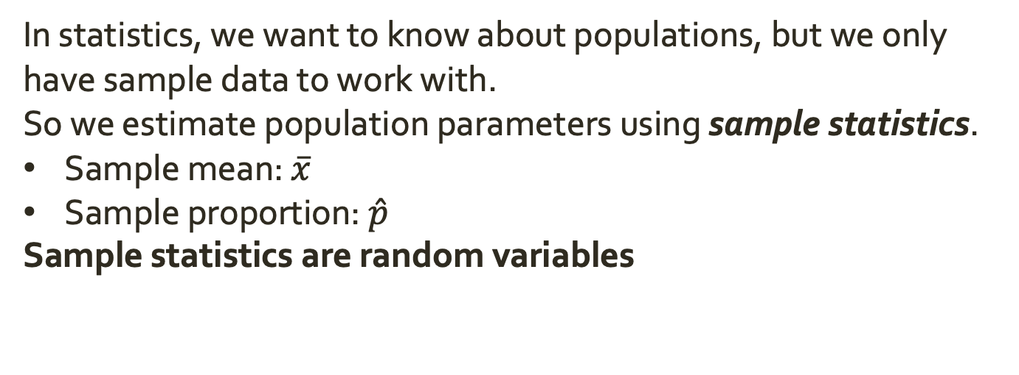
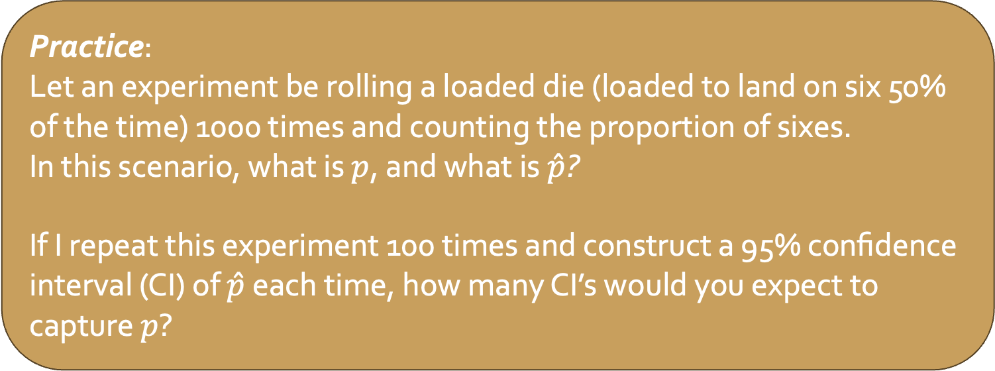
Warm Up: Statistics and CIs
In statistics, we want to know about populations, but we only have sample data to work with.
So we estimate population parameters using sample statistics.
Sample mean: $\overline{x}$
Sample proportion: $\hat{p}$
Sample statistics are random variables
Practice:
Let an experiment be rolling a loaded die (loaded to land on six 50% of the time) 1000 times and counting the proportion of sixes.
In this scenario, what is $p$, and what is $\hat{p}$?
If I repeat this experiment 100 times and construct a 95% confidence interval (CI) of $\hat{p}$ each time, how many CI’s would you expect to capture $p$?

Slide 4
Models of Statistical Inference
Our sample statistics represent our best guess for the true population parameter. We know this best guess is not perfect; we expect error (variability) die to the sampling process.
Because we can’t know the truth directly we:
Construct a confidence interval
Expresses the uncertainty that we have in our estimate
Describes the range of plausible values given our observed data
Conduct a hypothesis test
Posits a specific explanation for how data were generated
Checks if the observed data is consistent with that explanation

Slide 5
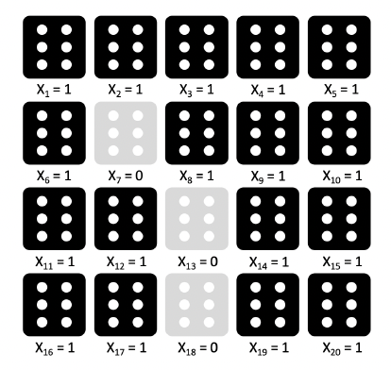
Loaded Die?
Recall an experiment where we gathered data by rolling a die 20 times. We observed 17 sixes:
This feels like evidence that the die is loaded, but how compelling is it? Is there a compelling alternative explanation for this data?

Slide 6
The Role of Random Chance
What if the die was fair?
We would expect to see around 1/6 of rolls be sixes, but due to chance we wouldn’t expect exactly 1/6 to be sixes

Slide 7
The Role of Random Chance
What if the die was fair?
We would expect to see around 1/6 of rolls be sixes, but due to chance we wouldn’t expect exactly 1/6 to be sixes
So…
If the die was truly fair, just how unusual would be be to observe 17 sixes in 20 rolls?
We can quantify this with a hypothesis test

Slide 8
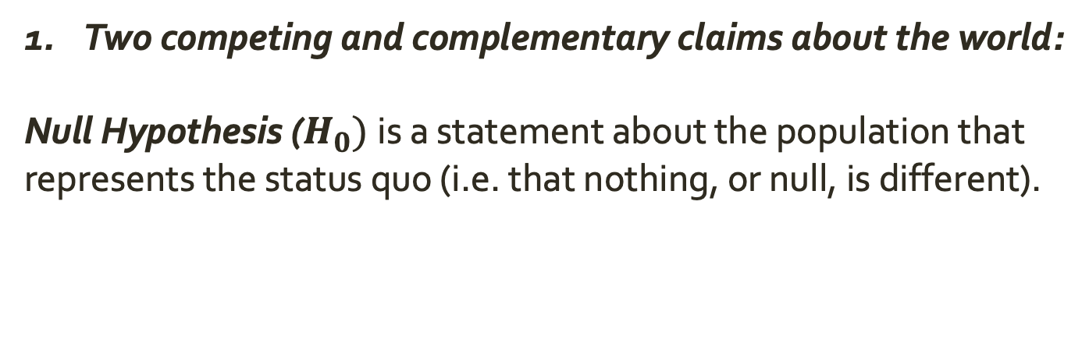
Pieces to a Hypothesis Test
Two competing and complementary claims about the world:
Null Hypothesis ($H_{0})$is a statement about the population that represents the status quo (i.e. that nothing, or null, is different).

Slide 9
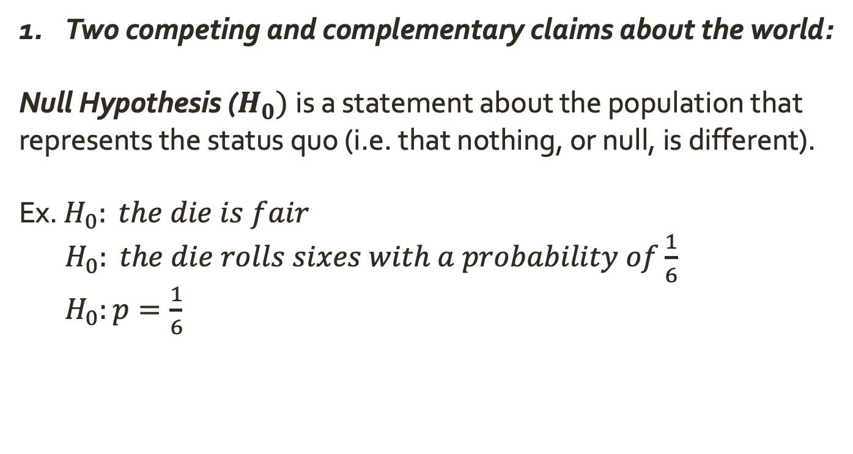
Pieces to a Hypothesis Test
Two competing and complementary claims about the world:
Null Hypothesis ($H_{0})$is a statement about the population that represents the status quo (i.e. that nothing, or null, is different).
Ex. $H_{0}: the die is fair$
$H_{0}: the die rolls sixes with a probability of\frac{1}{6}$
$H_{0}:p=\frac{1}{6}$

Slide 10
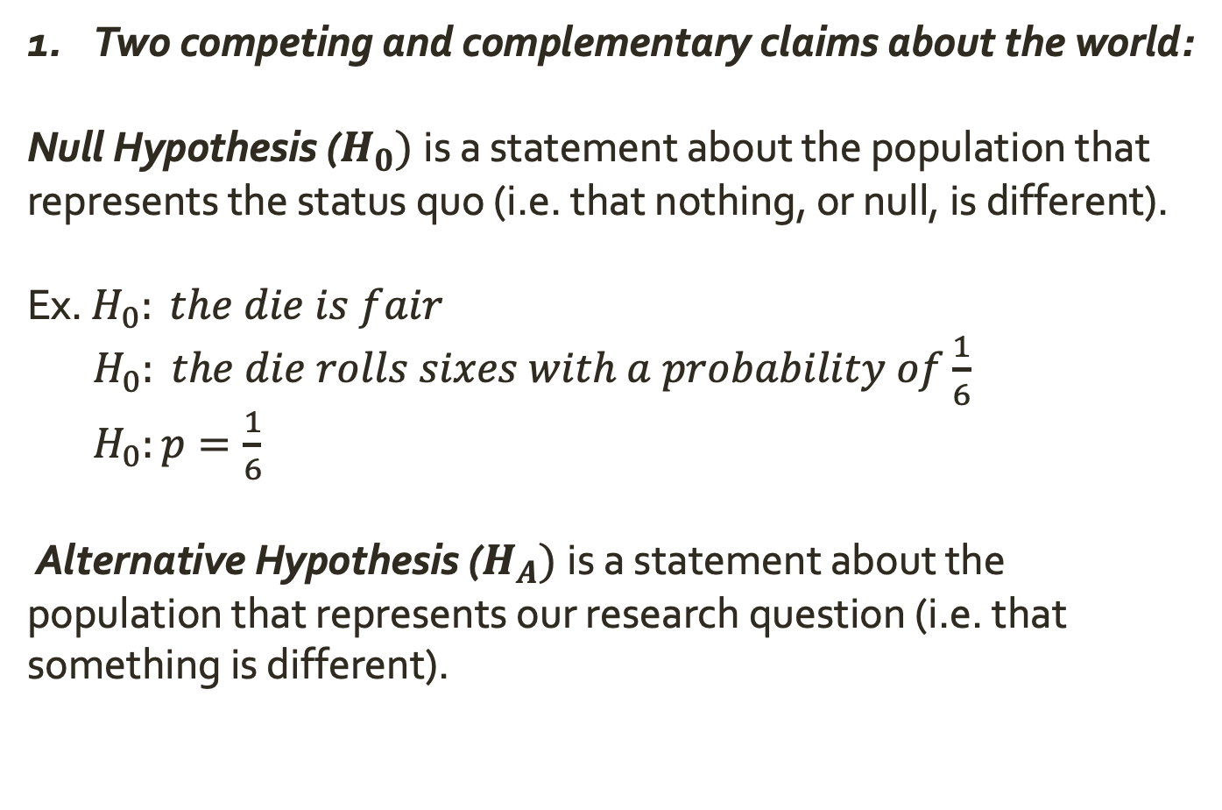
Pieces to a Hypothesis Test
Two competing and complementary claims about the world:
Null Hypothesis ($H_{0})$is a statement about the population that represents the status quo (i.e. that nothing, or null, is different).
Ex. $H_{0}: the die is fair$
$H_{0}: the die rolls sixes with a probability of\frac{1}{6}$
$H_{0}:p=\frac{1}{6}$
Alternative Hypothesis ($H_{A})$is a statement about the population that represents our research question (i.e. that something is different).

Slide 11
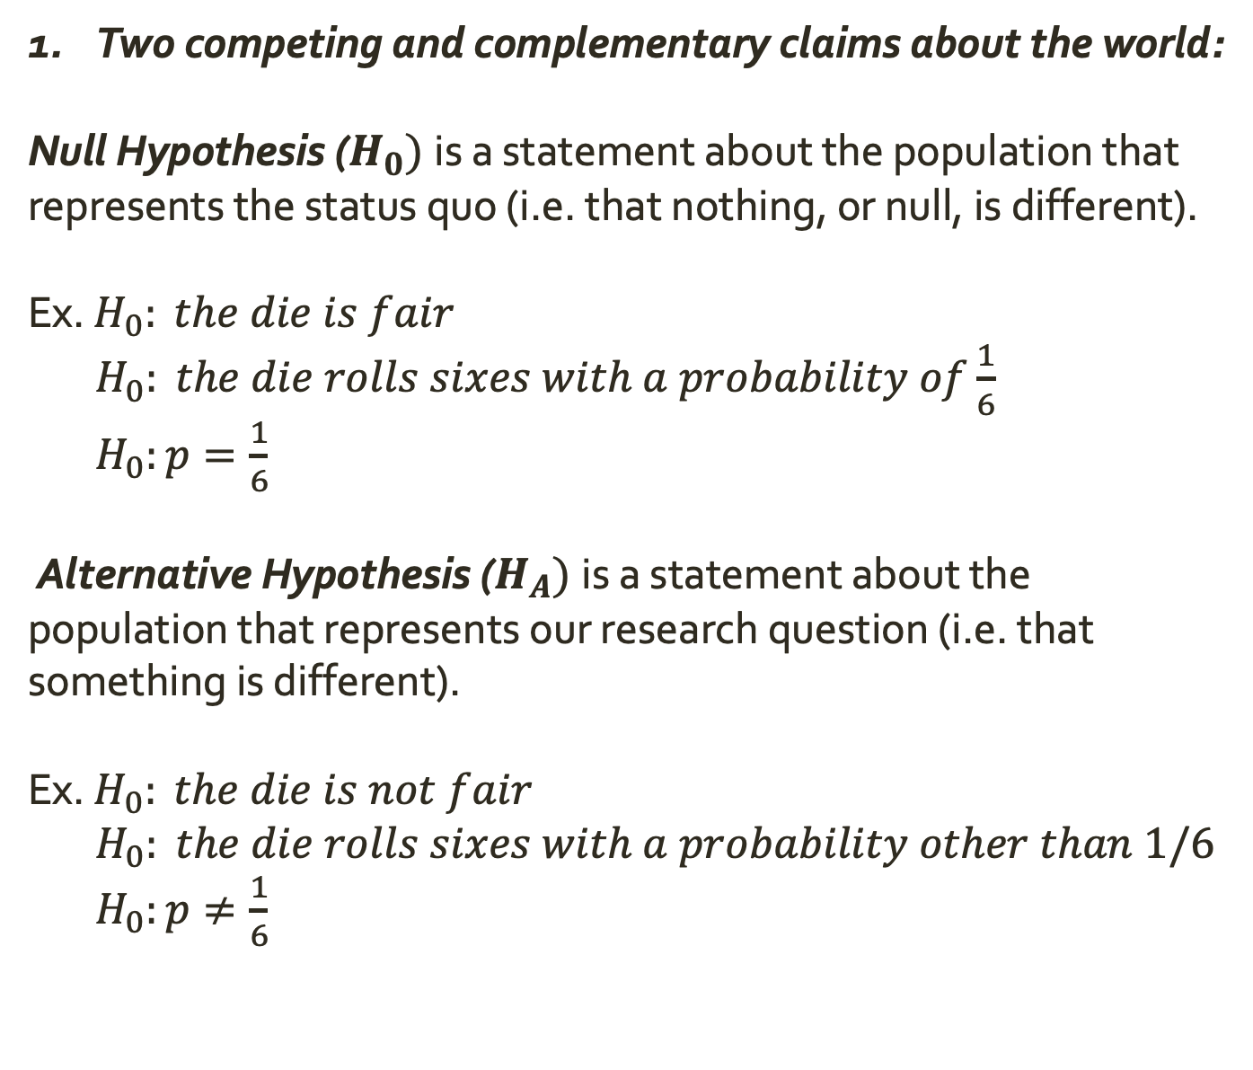
Pieces to a Hypothesis Test
Two competing and complementary claims about the world:
Null Hypothesis ($H_{0})$is a statement about the population that represents the status quo (i.e. that nothing, or null, is different).
Ex. $H_{0}: the die is fair$
$H_{0}: the die rolls sixes with a probability of\frac{1}{6}$
$H_{0}:p=\frac{1}{6}$
Alternative Hypothesis ($H_{A})$is a statement about the population that represents our research question (i.e. that something is different).
Ex. $H_{0}: the die is not fair$
$H_{0}: the die rolls sixes with a probability other than 1/6$
$H_{0}:p≠\frac{1}{6}$

Slide 12
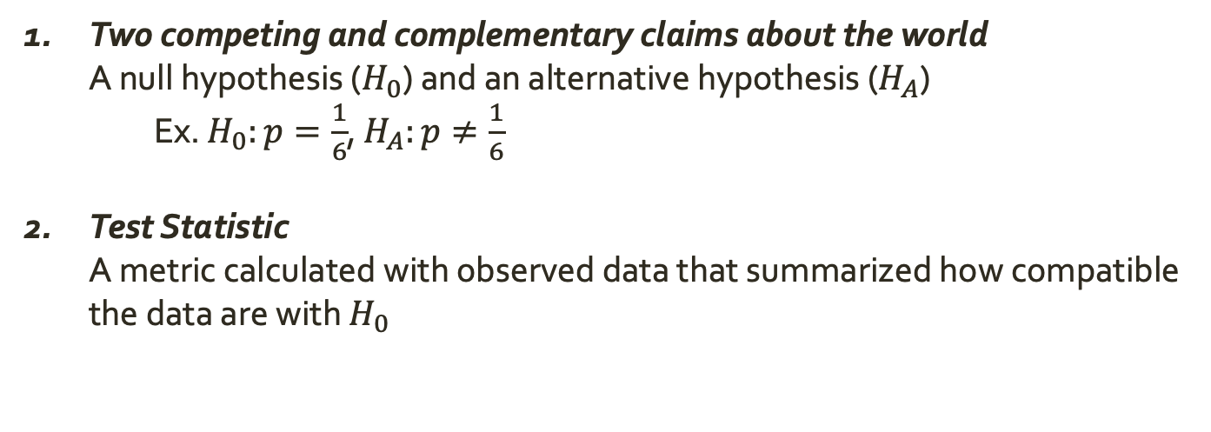
Pieces to a Hypothesis Test
Two competing and complementary claims about the world
A null hypothesis ($H_{0}$) and an alternative hypothesis ($H_{A}$)
Ex. $H_{0}:p=\frac{1}{6}$, $H_{A}:p≠\frac{1}{6}$
Test Statistic
A metric calculated with observed data that summarized how compatible the data are with $H_{0}$
What is our test statistic for our die experiment where we observed 17 sixes in 20 rolls?

Slide 13
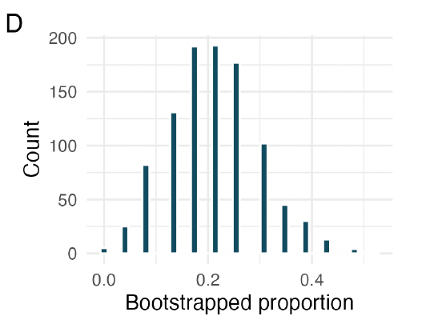
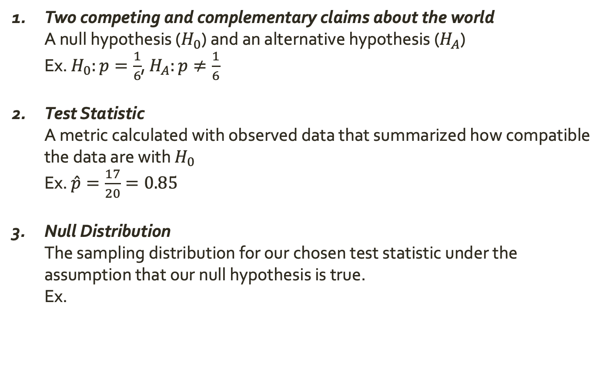
Pieces to a Hypothesis Test
Two competing and complementary claims about the world
A null hypothesis ($H_{0}$) and an alternative hypothesis ($H_{A}$)
Ex. $H_{0}:p=\frac{1}{6}$, $H_{A}:p≠\frac{1}{6}$
Test Statistic
A metric calculated with observed data that summarized how compatible the data are with $H_{0}$
Ex. $\hat{p}=\frac{17}{20}=0.85$
Null Distribution
The sampling distribution for our chosen test statistic under the assumption that our null hypothesis is true.
Ex.

Slide 14
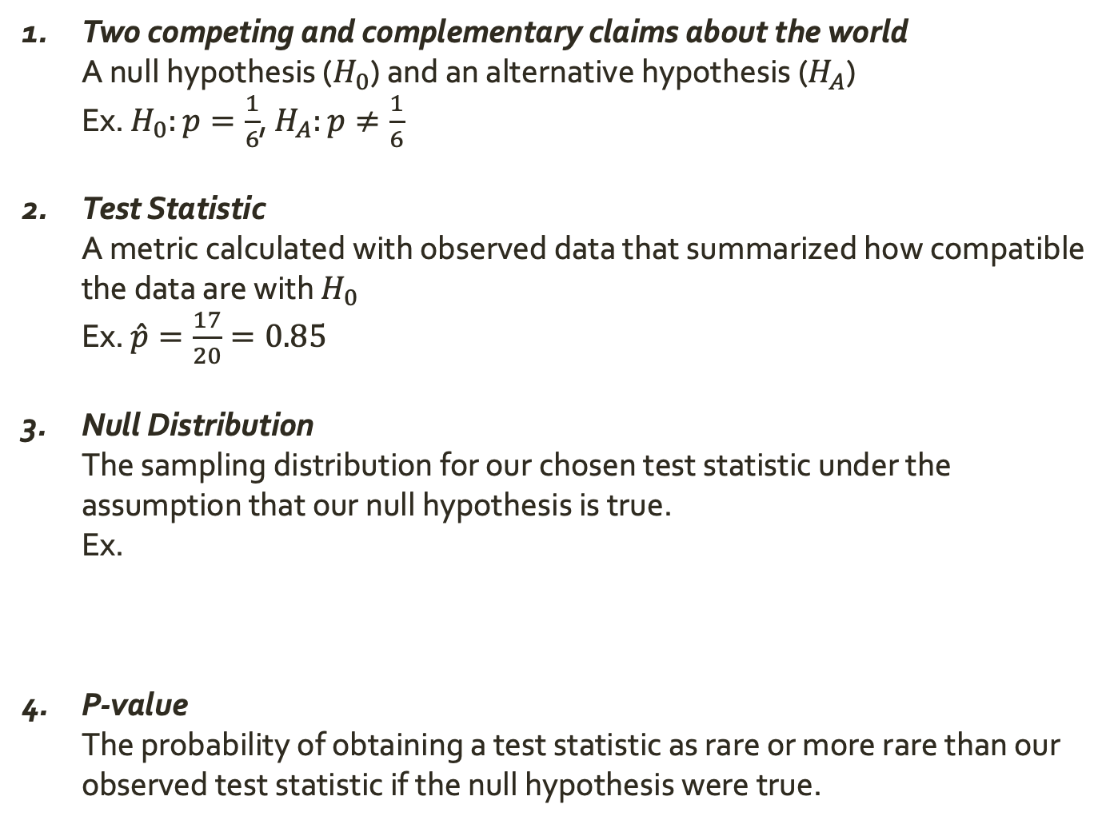
Pieces to a Hypothesis Test
Two competing and complementary claims about the world
A null hypothesis ($H_{0}$) and an alternative hypothesis ($H_{A}$)
Ex. $H_{0}:p=\frac{1}{6}$, $H_{A}:p≠\frac{1}{6}$
Test Statistic
A metric calculated with observed data that summarized how compatible the data are with $H_{0}$
Ex. $\hat{p}=\frac{17}{20}=0.85$
Null Distribution
The sampling distribution for our chosen test statistic under the assumption that our null hypothesis is true.
Ex.
P-value
The probability of obtaining a test statistic as rare or more rare than our observed test statistic if the null hypothesis were true.

Slide 15
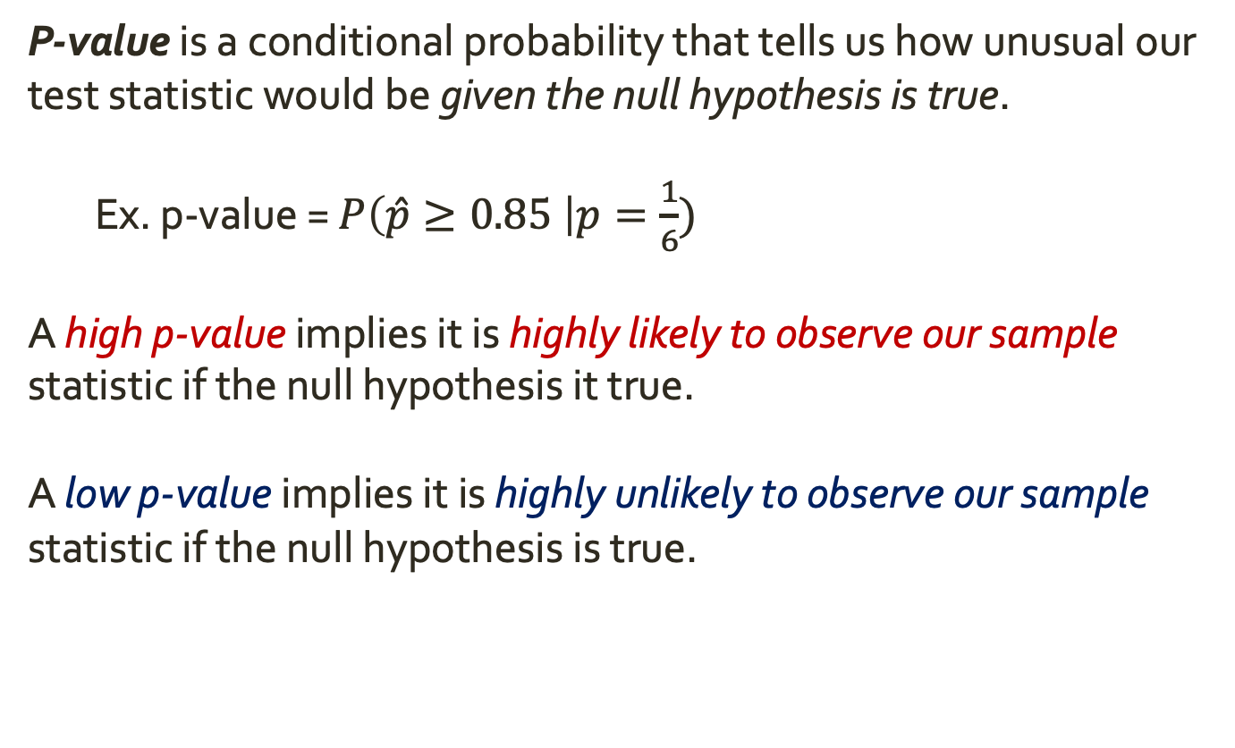
P-Values
P-value is a conditional probability that tells us how unusual our test statistic would be given the null hypothesis is true.
Ex. p-value = $P\left(\hat{p}≥0.85 \right|p=\frac{1}{6})$
A high p-value implies it is highly likely to observe our sample statistic if the null hypothesis it true.
A low p-value implies it is highly unlikely to observe our sample statistic if the null hypothesis is true.

Slide 16
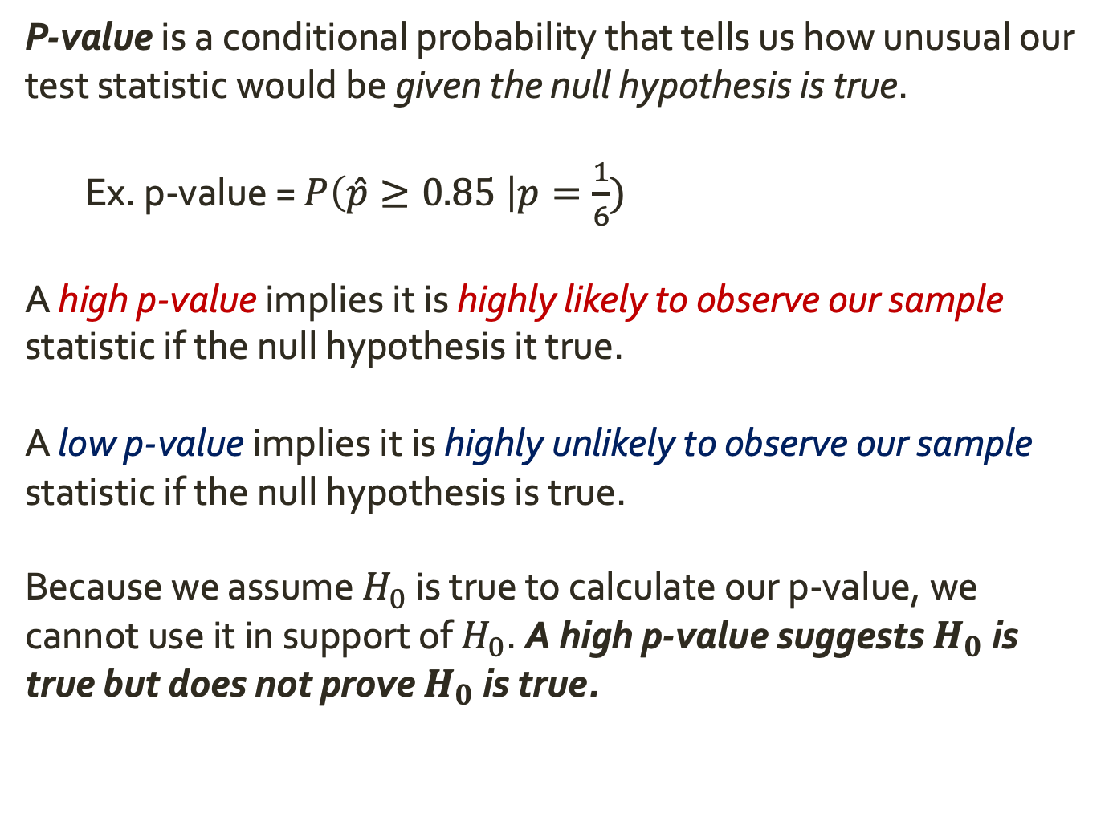
P-Values
P-value is a conditional probability that tells us how unusual our test statistic would be given the null hypothesis is true.
Ex. p-value = $P\left(\hat{p}≥0.85 \right|p=\frac{1}{6})$
A high p-value implies it is highly likely to observe our sample statistic if the null hypothesis it true.
A low p-value implies it is highly unlikely to observe our sample statistic if the null hypothesis is true.
Because we assume $H_{0}$ is true to calculate our p-value, we cannot use it in support of $H_{0}$. A high p-value suggests $H_{0}$ is true but does not prove $H_{0}$ is true.

Slide 17
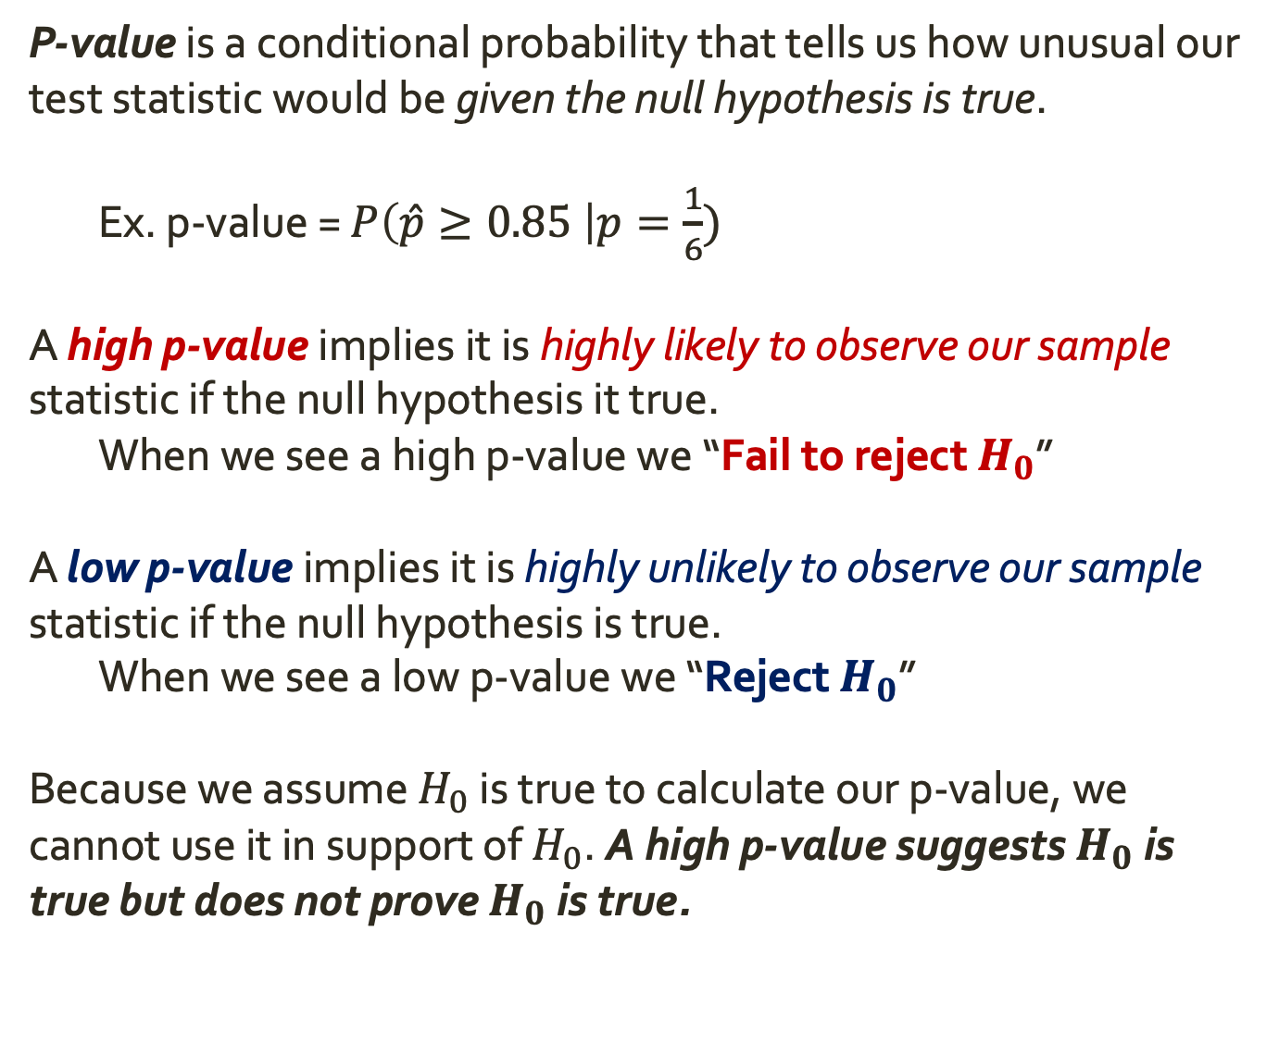
P-Values
P-value is a conditional probability that tells us how unusual our test statistic would be given the null hypothesis is true.
Ex. p-value = $P\left(\hat{p}≥0.85 \right|p=\frac{1}{6})$
A high p-value implies it is highly likely to observe our sample statistic if the null hypothesis it true.
When we see a high p-value we “Fail to reject $H_{0}$”
A low p-value implies it is highly unlikely to observe our sample statistic if the null hypothesis is true.
When we see a low p-value we “Reject $H_{0}$”
Because we assume $H_{0}$ is true to calculate our p-value, we cannot use it in support of $H_{0}$. A high p-value suggests $H_{0}$ is true but does not prove $H_{0}$ is true.

Slide 18
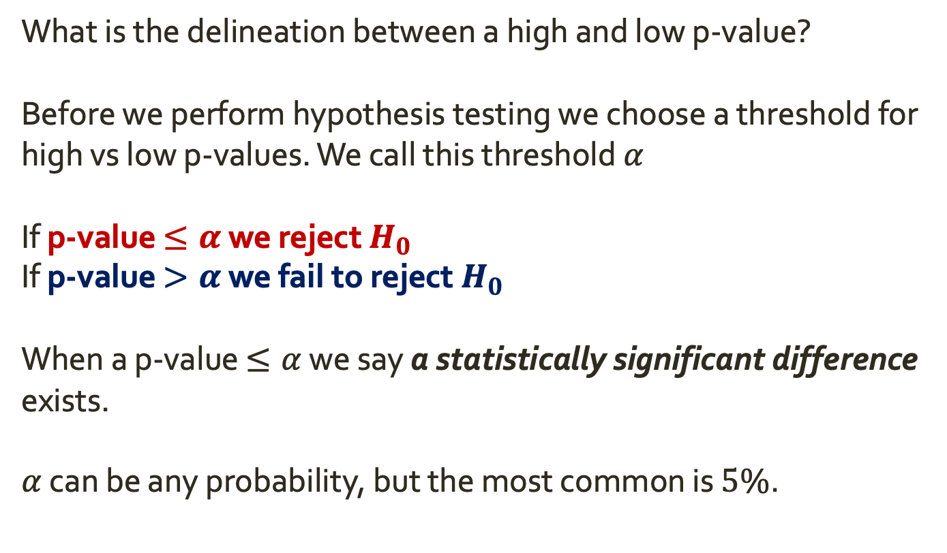
P-Values
What is the delineation between a high and low p-value?
Before we perform hypothesis testing we choose a threshold for high vs low p-values. We call this threshold $α$
If p-value $≤α$ we reject $H_{0}$
If p-value $>α$ we fail to reject $H_{0}$
When a p-value $≤α$ we say a statistically significant difference exists.
$α$ can be any probability, but the most common is $5\%$.

Slide 19
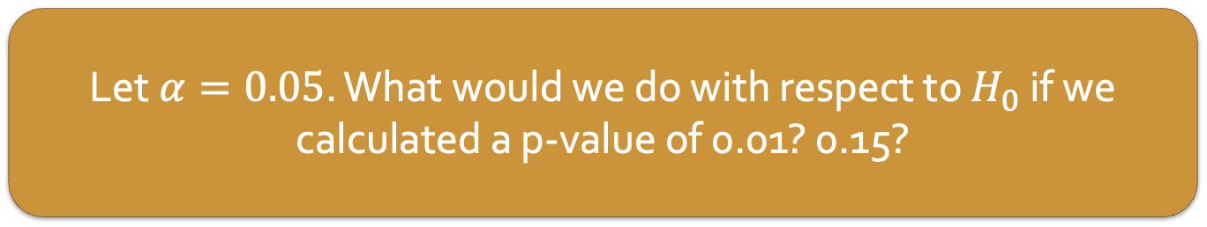
P-Values
What is the delineation between a high and low p-value?
Before we perform hypothesis testing we choose a threshold for high vs low p-values. We call this threshold $α$
If p-value $≤α$ we reject $H_{0}$
If p-value $>α$ we fail to reject $H_{0}$
When a p-value $≤α$ we say a statistically significant difference exists.
$α$ can be any probability, but the most common is $5\%$.
Let $α=0.05$. What would we do with respect to $H_{0}$ if we calculated a p-value of 0.01? 0.15?

Slide 20
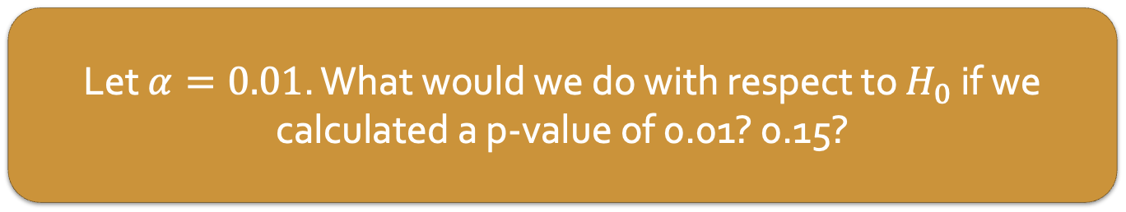
P-Values
What is the delineation between a high and low p-value?
Before we perform hypothesis testing we choose a threshold for high vs low p-values. We call this threshold $α$
If p-value $≤α$ we reject $H_{0}$
If p-value $>α$ we fail to reject $H_{0}$
When a p-value $≤α$ we say a statistically significant difference exists.
$α$ can be any probability, but the most common is $5\%$.
Let $α=0.01$. What would we do with respect to $H_{0}$ if we calculated a p-value of 0.01? 0.15?

Slide 21
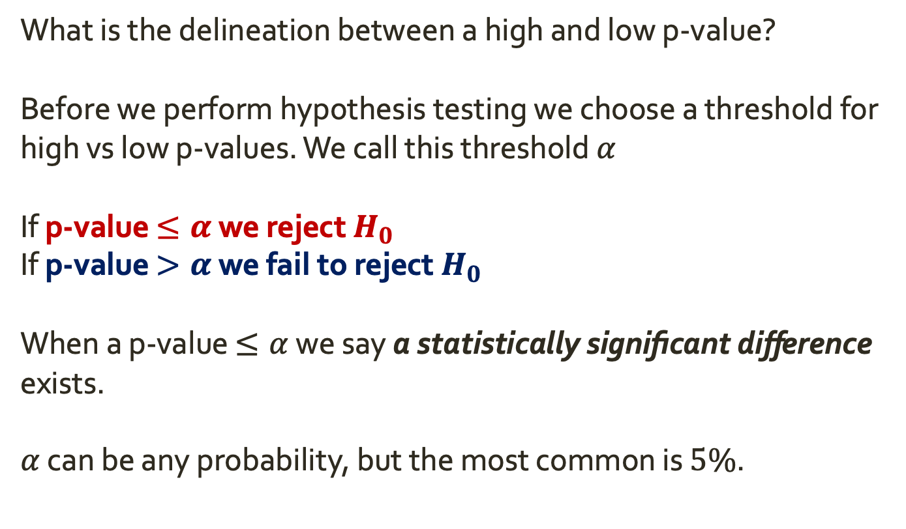
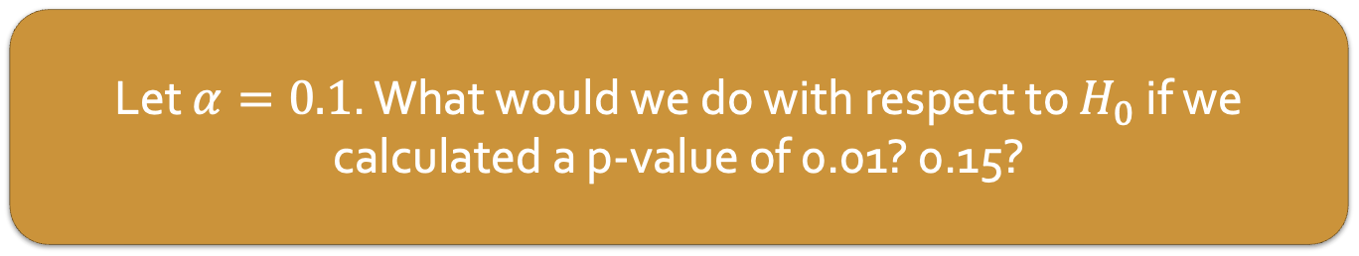
P-Values
What is the delineation between a high and low p-value?
Before we perform hypothesis testing we choose a threshold for high vs low p-values. We call this threshold $α$
If p-value $≤α$ we reject $H_{0}$
If p-value $>α$ we fail to reject $H_{0}$
When a p-value $≤α$ we say a statistically significant difference exists.
$α$ can be any probability, but the most common is $5\%$.
Let $α=0.1$. What would we do with respect to $H_{0}$ if we calculated a p-value of 0.01? 0.15?

Slide 22
P-Values
What is the delineation between a high and low p-value?
Before we perform hypothesis testing we choose a threshold for high vs low p-values. We call this threshold $α$
If p-value $≤α$ we reject $H_{0}$
If p-value $>α$ we fail to reject $H_{0}$
When a p-value $≤α$ we say a statistically significant difference exists.
$α$ can be any probability, but the most common is $5\%$.
Let $α=0.1$. What would we do with respect to $H_{0}$ if we calculated a p-value of 0.01? 0.15?

Slide 23
P-Values
A p-value is the probability of obtaining a test statistic as rare or more rare than our observed test statistic if the null hypothesis were true.
How do we get the p-value?

Slide 24
P-Values
A p-value is the probability of obtaining a test statistic as rare or more rare than our observed test statistic if the null hypothesis were true.
How do we get the p-value? From our null distribution, generated with bootstrap.

Slide 25
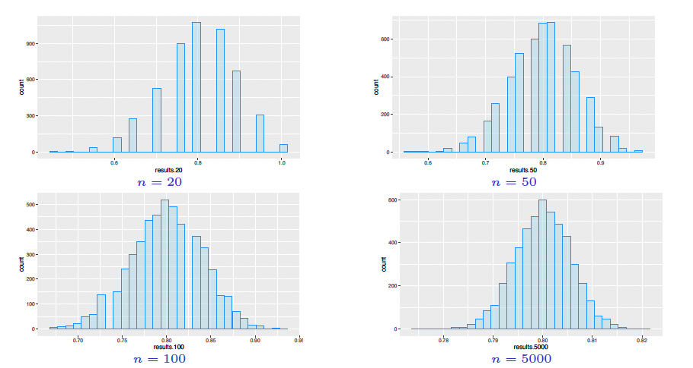
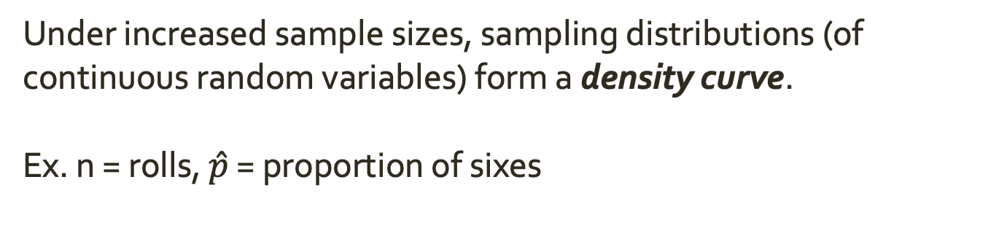
Null Distribution
Under increased sample sizes, sampling distributions (of continuous random variables) form a density curve.
Ex. n = rolls, $\hat{p}$ = proportion of sixes

Slide 26
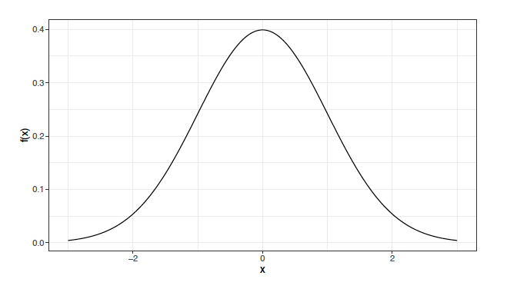
Central Limit Theorem
The central limit theorem states if observations in a sample are independent and the size of the sample is large, then the sampling distribution of a parameter is well-approximated the Normal distribution.
Symmetric, unimodal, bell-shaped

Slide 27
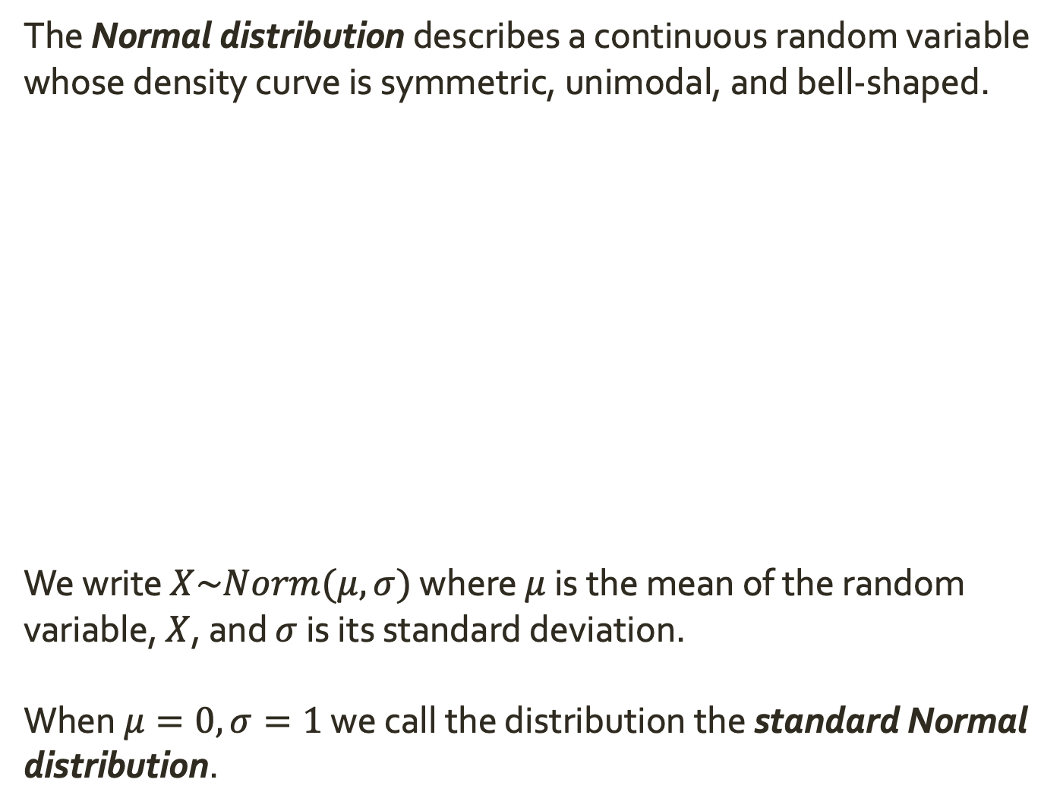
Normal Distribution
The Normal distribution describes a continuous random variable whose density curve is symmetric, unimodal, and bell-shaped.
We write $X\sim Norm(μ,σ)$ where $μ$ is the mean of the random variable, $X$, and $σ$ is its standard deviation.
When $μ=0, σ=1$ we call the distribution the standard Normal distribution.

Slide 28
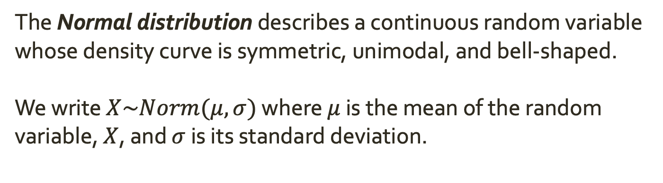

Normal Distribution
The Normal distribution describes a continuous random variable whose density curve is symmetric, unimodal, and bell-shaped.
We write $X\sim Norm(μ,σ)$ where $μ$ is the mean of the random variable, $X$, and $σ$ is its standard deviation.
The curve is centered at $μ$

Slide 29
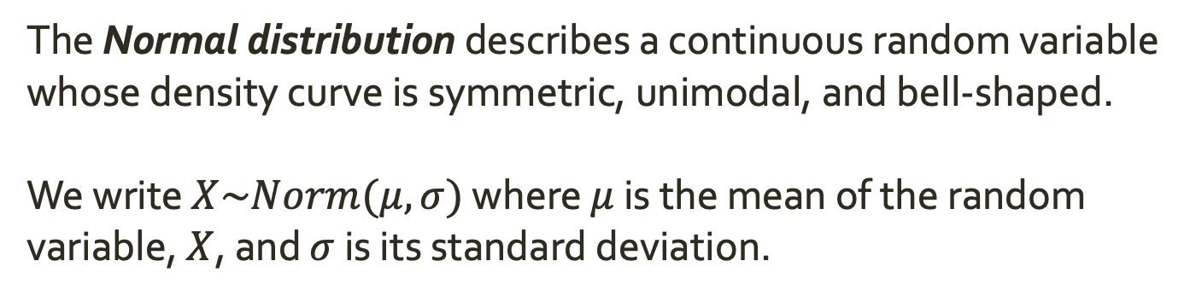
Normal Distribution
The Normal distribution describes a continuous random variable whose density curve is symmetric, unimodal, and bell-shaped.
We write $X\sim Norm(μ,σ)$ where $μ$ is the mean of the random variable, $X$, and $σ$ is its standard deviation.
Total area under the curve = 1

Slide 30
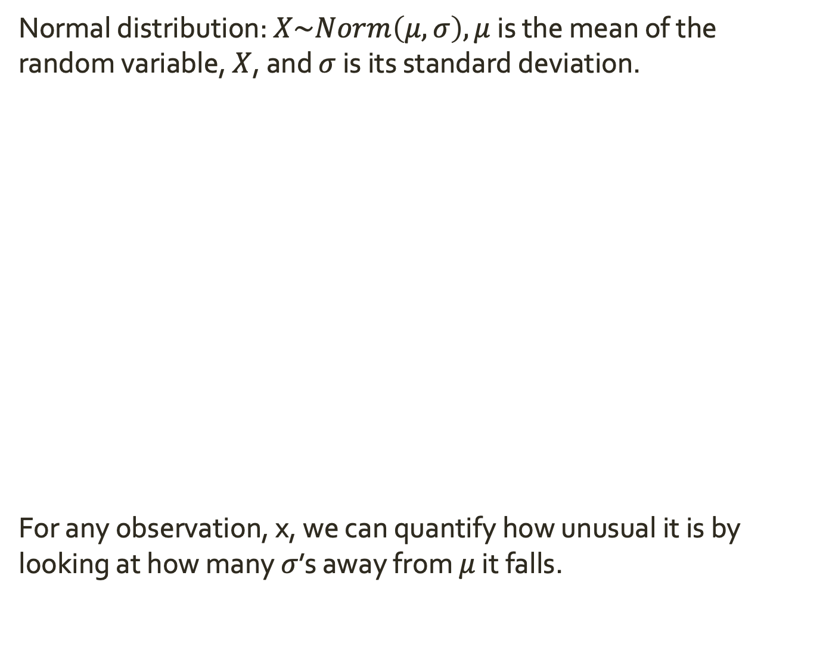

Normal Distribution
Normal distribution: $X\sim Norm\left(μ,σ\right), μ$ is the mean of the random variable, $X$, and $σ$ is its standard deviation.
For any observation, x, we can quantify how unusual it is by looking at how many $σ$’s away from $μ$ it falls.
$$μ$$
x

Slide 31
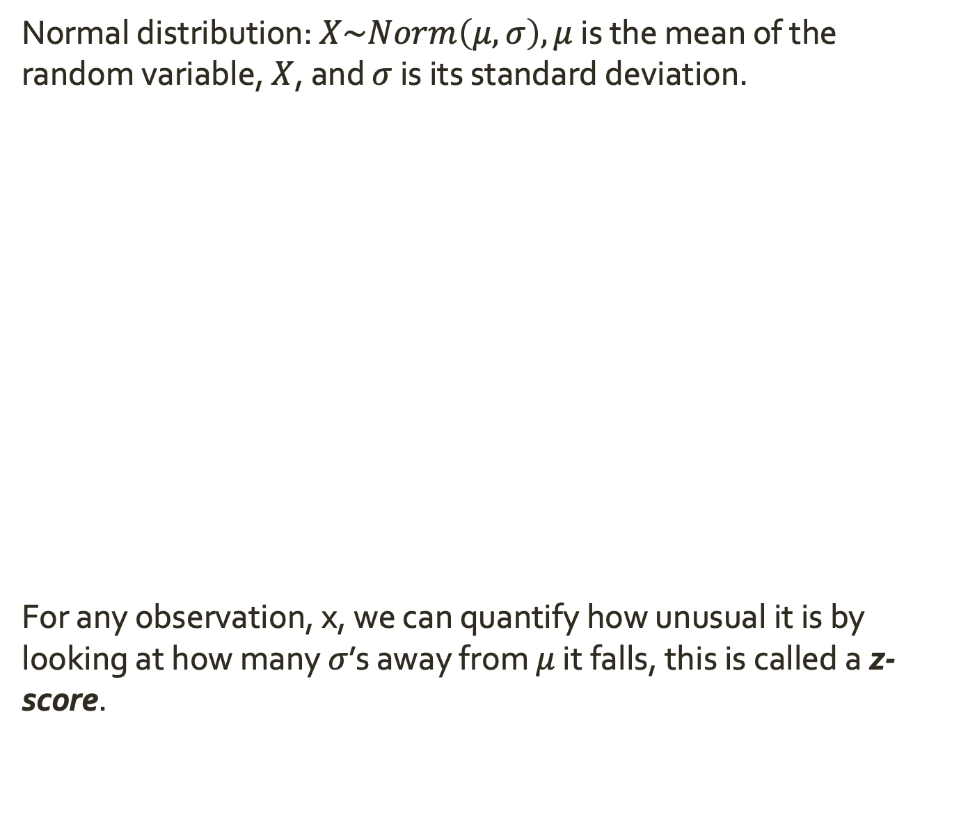

Normal Distribution
Normal distribution: $X\sim Norm\left(μ,σ\right), μ$ is the mean of the random variable, $X$, and $σ$ is its standard deviation.
For any observation, x, we can quantify how unusual it is by looking at how many $σ$’s away from $μ$ it falls, this is called a z-score.
$$μ$$
x
$$Z$$

Slide 32

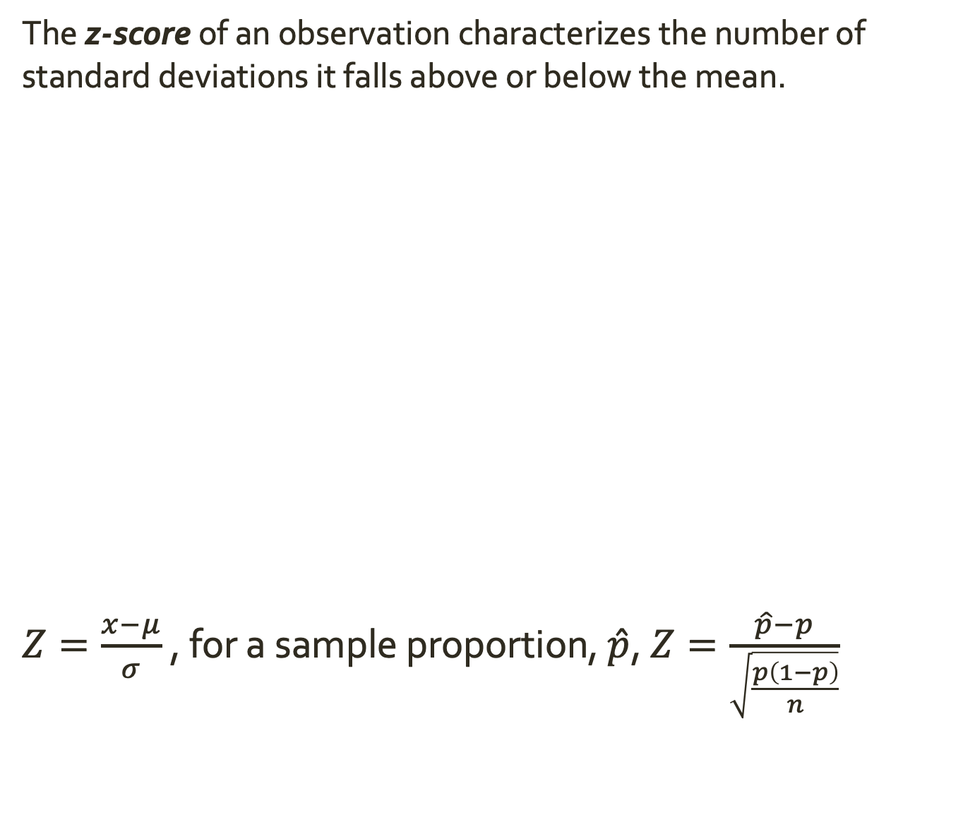


Z-scores
The z-score of an observation characterizes the number of standard deviations it falls above or below the mean.
$Z=\frac{x−μ}{σ}$ , for a sample proportion, $\hat{p}$, $Z=\frac{\hat{p}−p}{\sqrt{\frac{p\left(1−p\right)}{n}}}$
$$μ$$
x
$$Z$$
$$x$$
$$μ$$
$$σ$$

Slide 33
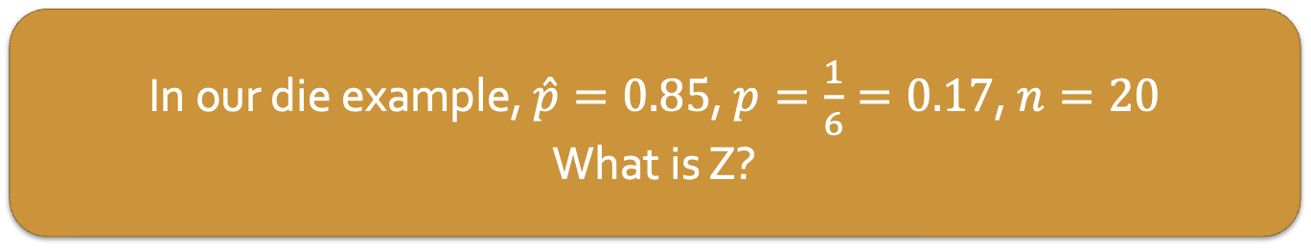
Z-scores
The z-score of an observation characterizes the number of standard deviations it falls above or below the mean.
$Z=\frac{x−μ}{σ}$ , for a sample proportion, $\hat{p}$, $Z=\frac{\hat{p}−p}{\sqrt{\frac{p\left(1−p\right)}{n}}}$
In our die example, $\hat{p}=0.85$, $p=\frac{1}{6}=0.17$, $n=20$
What is Z?
$$μ$$
x
$$Z$$
$$x$$
$$μ$$
$$σ$$
Notes:
Z = 8.1

Slide 34
Z-scores
The z-score of an observation characterizes the number of standard deviations it falls above or below the mean.
$Z=\frac{x−μ}{σ}$ , for a sample proportion, $\hat{p}$, $Z=\frac{\hat{p}−p}{\sqrt{\frac{p\left(1−p\right)}{n}}}$
If we rolled 40 times and saw 10 sixes, what would Z be?
$$μ$$
x
$$Z$$
$$x$$
$$μ$$
$$σ$$
Notes:
Z = 1.34

Slide 35
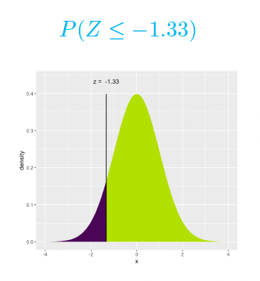
Z-scores
Given a z-score, we can use the standard normal distribution to find several probabilities.
Probability that of seeing an observation less than or equal to x:
Area under the curve to the left of the z-score = probability of seeing a smaller z-score. Often called the percentile.

Slide 36
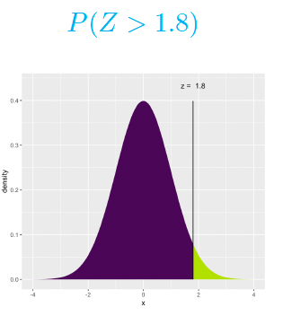
Z-scores
Given a z-score, we can use the standard normal distribution to find several probabilities.
Probability that of seeing an observation greater than x:
Area under the curve to the right of the z-score = probability of seeing a larger z-score.

Slide 37
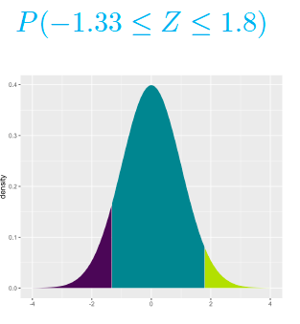
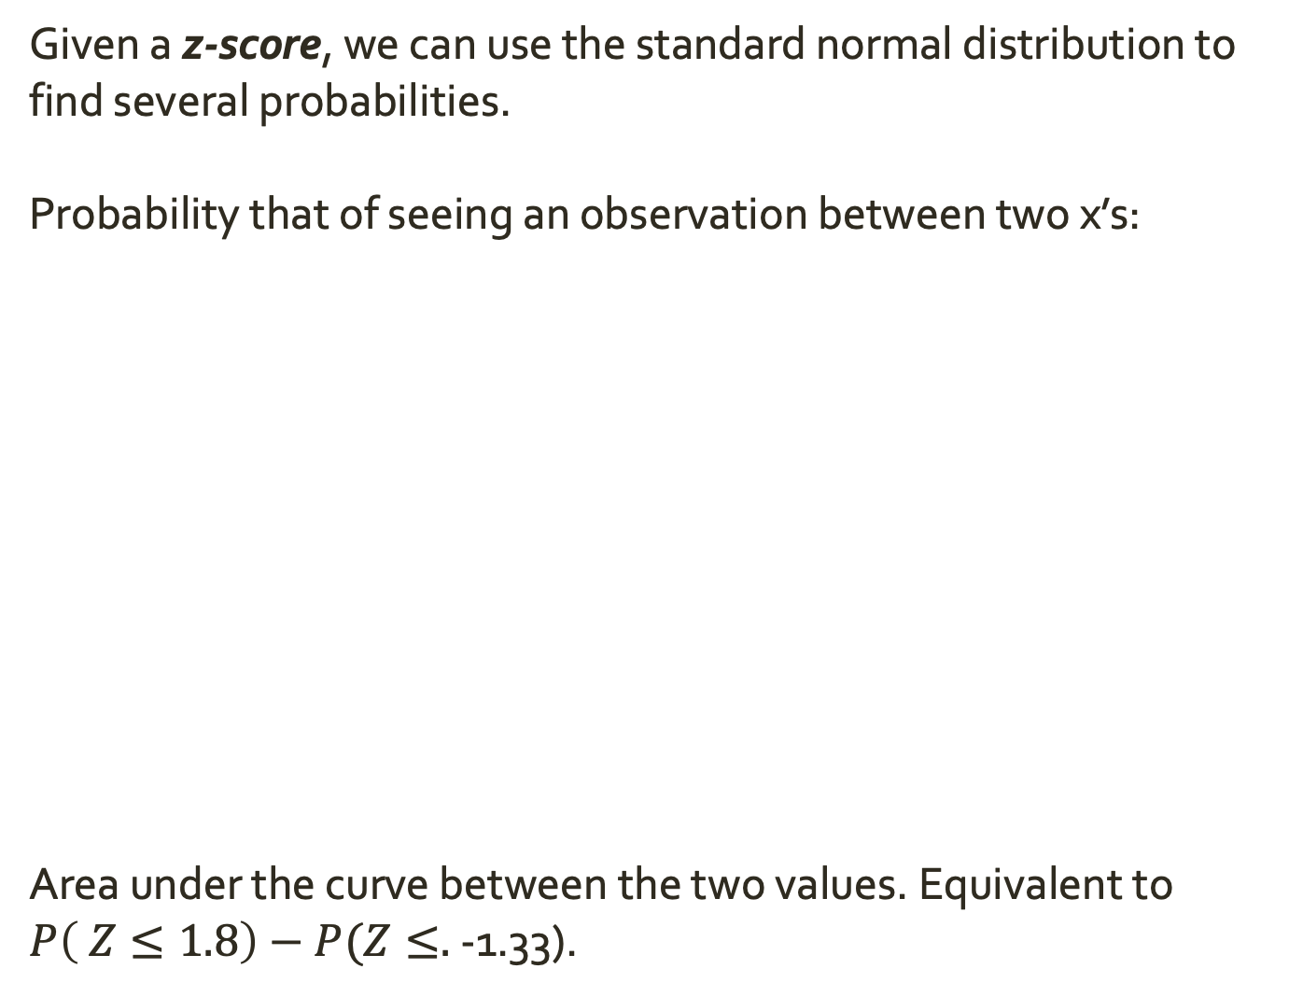
Z-scores
Given a z-score, we can use the standard normal distribution to find several probabilities.
Probability that of seeing an observation between two x’s:
Area under the curve between the two values. Equivalent to $P\left( Z≤1.8\right)−P(Z≤.$-1.33).

Slide 38
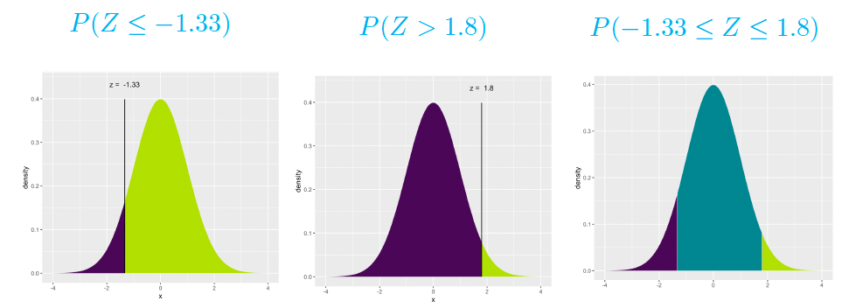
Z-scores
Given a z-score, we can use the standard normal distribution to find several probabilities.

Slide 39
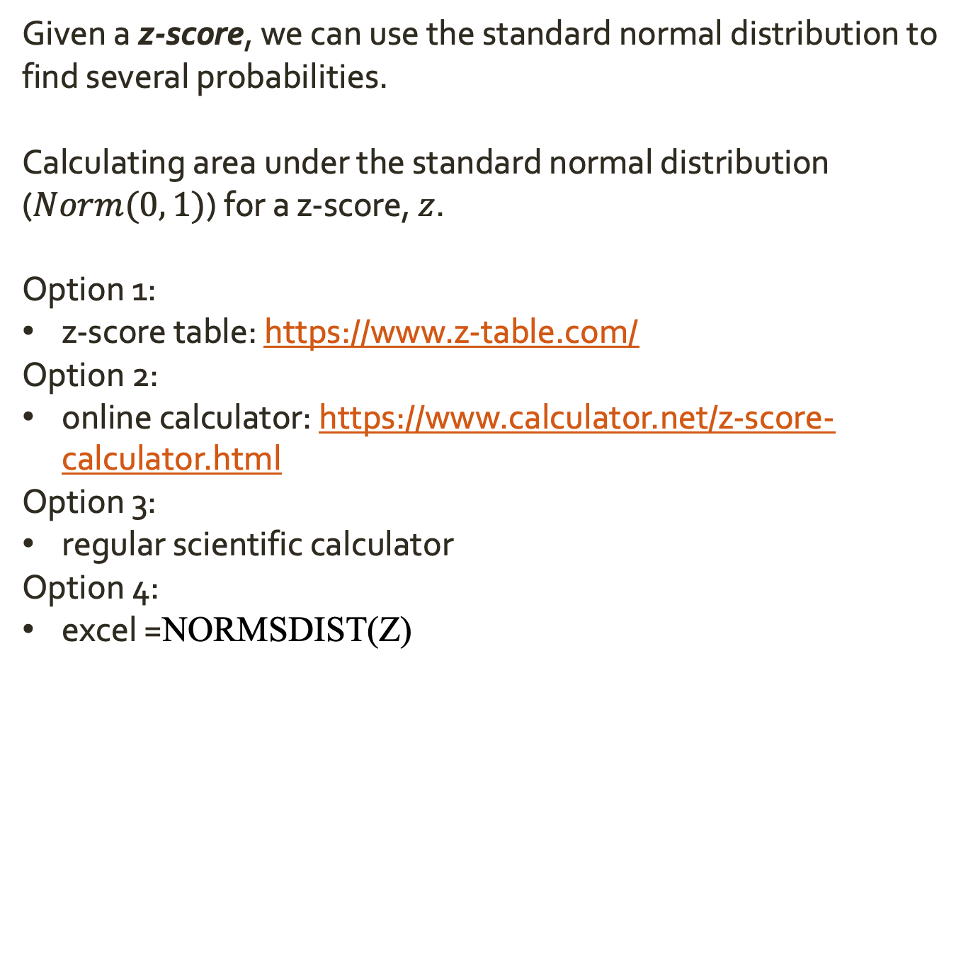
Z-scores
Given a z-score, we can use the standard normal distribution to find several probabilities.
Calculating area under the standard normal distribution ($Norm(0, 1)$) for a z-score, $z$.
Option 1:
z-score table: https://www.z-table.com/
Option 2:
online calculator: https://www.calculator.net/z-score-calculator.html
Option 3:
regular scientific calculator
Option 4:
excel =NORMSDIST(Z)

Slide 40
Z-scores
Given a z-score, we can use the standard normal distribution to find several probabilities.
Calculating area under the standard normal distribution ($Norm(0, 1)$) for a z-score, $z$.
Option 1:
z-score table: https://www.z-table.com/
Option 2:
online calculator: https://www.calculator.net/z-score-calculator.html
Option 3:
regular scientific calculator
Option 4:
excel =NORMSDIST(Z)
What str the percentiles for z = 8.1, and for z = 1.34?
Notes:
percentile for 8.1 – 1
percentile for 1.34 = 0.90988

Slide 41


Z-scores
Given a z-score, we can use the standard normal distribution to find several probabilities.
The probability of seeing an observation as or more extreme than the one we saw given our null hypothesis is the probability of seeing a z-score as or more extreme than the z-score we got for our observation.
$$p−value$$
$$p−value$$

Slide 42

Z-scores
Given the percentile 1 for z = 8.1 (from $\hat{p}=0.85$), what is the p-value?
Given the percentile 0.91 for z = 1.34. (from $\hat{p}=0.25$), what is the p-value?
Given a z-score, we can use the standard normal distribution to find several probabilities.
The probability of seeing an observation as or more extreme than the one we saw given our null hypothesis is the probability of seeing a z-score as or more extreme than the z-score we got for our observation.
$$p−value$$
$$p−value$$
Notes:
p = 0
p = 0.09

Slide 43
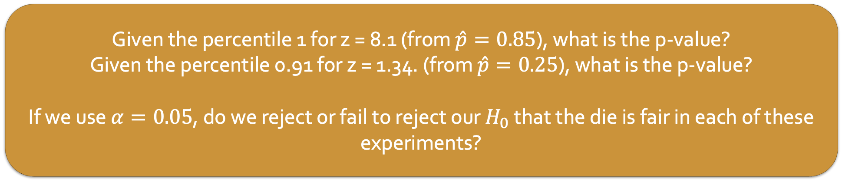
Z-scores
Given the percentile 1 for z = 8.1 (from $\hat{p}=0.85$), what is the p-value?
Given the percentile 0.91 for z = 1.34. (from $\hat{p}=0.25$), what is the p-value?
If we use $α=0.05$, do we reject or fail to reject our $H_{0}$ that the die is fair in each of these experiments?
Given a z-score, we can use the standard normal distribution to find several probabilities.
The probability of seeing an observation as or more extreme than the one we saw given our null hypothesis is the probability of seeing a z-score as or more extreme than the z-score we got for our observation.
$$p−value$$
$$p−value$$
Notes:
Reject!
Fail to reject!

Slide 44
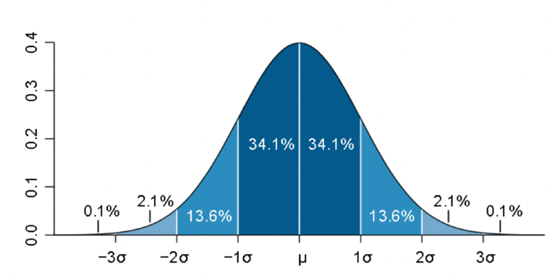
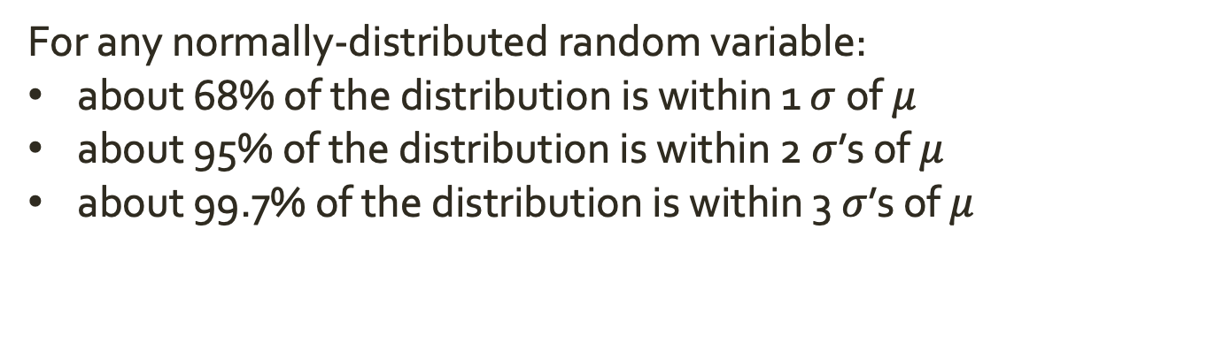
Z-scores
For any normally-distributed random variable:
about 68% of the distribution is within 1 $σ$ of $μ$
about 95% of the distribution is within 2 $σ$’s of $μ$
about 99.7% of the distribution is within 3 $σ$’s of $μ$

